Slide 1

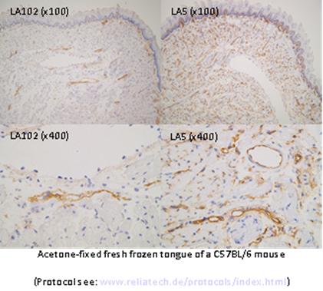
ReliaTech GmbH
Rat anti-mouse LEC26 / Bec12
(LEC26: Cat #103-M152; BEC12: Cat# 103-M154)
K22973
K22974
Fig. 1: Specificity: LA102 reacts with mouse lymphatic vessels except the thoracic duct and the marginal sinus of lymph nodes, but not with any blood vessels. LA102 recognized a protein of around 26 kDa. The antigen recognized by LA102 was localized on both luminal and abluminal lymphatic endothelial cell membranes. Besides lymphatics, some lymphoid cells are also recognized.
The antibody does not cross react with tissues of other species such as human, rat, guinea pig and chicken.
http://www.reliatech.de / orders@reliatech.de

